Slide 1
Artificial Intelligence | Unit 6
APPLICATION OF
AI
Components, Architecture & Development
Presented By:
Ishan Poudel
Subina Maharjan
Lumana Manandhar
Regisha Maharjan
Aayush Chaudhary
Preshna Thapa
Artificial Intelligence | Unit 6

Slide 2
Expert
System
(ES)
Expert System(ES)
An expert System is a branch of AI that focuses on mimicking human experts in specific domains such as healthcare and medicine.
An expert System is an “Intelligent” program that solve problem in narrow Area with high level of speciality.
Uses rules and knowledge to solve problems.
Presented By: Ishan Poudel

Slide 3
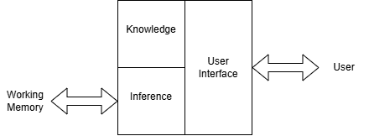
Components of Expert System
User
User Interface
Inference
Justifies system's conclusions
Query input & result display layer
Applies logic — forward & backward chaining
Knowledge
Working Memory
Stores domain facts & IF-THEN rules
Holds current problem session data
Presented By: Ishan Poudel

Slide 4
Knowledge base
The knowledge base stores all the domain-specific knowledge required to solve a problem. It includes facts and rules, usually in IF–THEN form, which are collected from human experts.
Stores Domain specific Knowledge
Knowledge extracted & structured into rules/facts
Stored in a formal representation (logic, frames, scripts)
Two types of knowledge:
Facts (static truths)
Rules (IF-THEN statements)
Presented By: Ishan Poudel

Slide 5
Inference Engine
It is a core part of Expert System that is responsible foe reasoning and applying logic to the knowledge base
Draws conclusions and makes decisions
Controls the overall execution of the system
Backward chaining
Forward chaining
Goal-Driven Approach
Data-Driven Approach
Starts from a hypothesis/goal and works backward to verify if the known facts support it.
Starts from known facts and applies rules to derive new conclusions until goal is reached.
Set Goal/Hypothesis
Known Facts
Find Rules that Prove It
Apply Matching Rule
✓ Verify with Known Facts
✓ Repeat until Goal
Presented By: Ishan Poudel

Slide 6
User Interface
Interface between user and expert system
Displays results and explanations clearly
Makes the system usable by non-experts
Data Flow:
User Query
⟶
User Interface
⟶
Inference Engine
Presented By: Ishan Poudel

Slide 7
Working Memory
Also called the Global Database or Blackboard — stores temporary facts for the current session.
Key Properties
Example — Medical Diagnosis Session
Holds facts specific to the current problem
Updated dynamically as reasoning progresses
New facts added by the inference engine stored here
Cleared or reset after each session ends
Separate from the permanent Knowledge Base
Input
Patient: fever 39°C, cough, fatigue
Derived
Symptom match → suspect respiratory infection
Derived
WBC count normal → likely viral, not bacterial
Output
Conclusion: Viral flu — recommend rest + fluids
After
Session ends → Working Memory cleared
Presented By: Ishan Poudel

Slide 8
Development Of Expert System
1
Identification
2
Conceptualization
3
Formalization
Identification :Determining the characteristics of the problem
Conceptualization: Finding Concept to Represent the knowledge
Formalization : Designing structure to organize the knowledge
4
Implementation
5
Testing
Implementation :Formulating rules that embody the Knowledge
Testing :Validating the rules
Presented By: Ishan Poudel

Slide 9
Natural Language Processing
Natural Language Processing is a technology that involves converting spoken or written human language into a form that can be processed by computers and vice versa.
It is an attempt to extract the fuller meaning representation from the free text.
Presented By: Subina Maharjan

Slide 10
Applications of Natural Language Processing
1
Voice Recognition Software
2
Text-to-speech synthesizers
3
Grammar and style checkers
4
Machine translation system
Presented By: Subina Maharjan

Slide 11
Natural Language Generation
Natural Language Generation is the natural language processing task of generating natural language from machine representation system such as knowledge base or logical form.
The different types of generation techniques is classified in four types:
1
Canned text Systems
2
Template Systems
3
Phrase-based Systems
4
Feature-based Systems
Presented By: Subina Maharjan

Slide 12
Natural Language Understanding
Understanding the language is not only the transmission of words.
Understanding user what actually mean. It is the process by which a computer understands and interprets human language in a meaningful way.
Presented By: Subina Maharjan

Slide 13
Steps of Natural Language Processing
1
2
3
4
→
→
→
Lexical Analysis
Syntactic Analysis
Semantic Analysis
Pragmatic Analysis
Presented By: Lumana Manandhar

Slide 14
Lexical Analysis
It is the process of recognizing the suffixes and prefixes that have been attached to a word.
Lexical analysis involves dividing a text into paragraphs, words and sentences.
The lexicon of a language is its vocabulary that includes its words and expressions.
It is also known as Morphological Analysis.
Presented By: Lumana Manandhar

Slide 15
Morphological Information
Feature
Example
Transform the part of speech
Green, greenness(adjective, noun)
Change feature of nouns
Boat, boats(singular, plural)
Bill slept, Bill’s bed
(subjective case, possessive case)
Change features
Aspect, Tense, Number and person
Aspect
I walk, I am walking(present, progressive)
Tense
I walked. I will walk. I had been walking.(past, future, past progressive)
Number and person
I walk. They walk.(first person singular, third person plural)
Presented By: Lumana Manandhar

Slide 16
Syntactic Analysis
It takes an input sentences and represents its grammatical structure.
Syntax concerns the proper ordering of words and its affect on meaning.
The words are transformed into the structure that shows how the words are related to each other.
Presented By: Lumana Manandhar

Slide 17
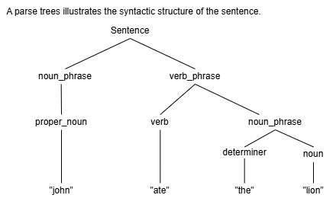
Syntactic Analysis — Example
Suppose we want a grammar that recognizes sentences like the following:
✓ Valid Sentences
John ate the biscuit
The lion ate the zebra.
But reject incorrect sentences such as
✗ Invalid Sentences
Ate John biscuit the.
Zebra the lion the ate.
Presented By: Lumana Manandhar

Slide 18
Semantic Analysis
Semantics concerns the (literal) meanings of words, phrases and sentences.
It is the process of converting syntactic representations into meaningful representations.
The structure which are created by the syntactic analyzer are assigned meanings.
Eg: “Colorless blue idea”. This would be rejected by the analyzer as colorless blue don’t make any sense together
Presented By: Lumana Manandhar

Slide 19
Semantic Analysis — Tasks
It involves the following tasks:
Word Sense
Sentence level analysis
Bat=’a baseball thing’
Bat=’a flying mammal’
I saw an astronaut with a telescope
Knowledge Representation
Using predicate logic for sentences
“John likes Marry” likes(John, Marry)
Presented By: Lumana Manandhar

Slide 20
Pragmatic Analysis
Pragmatics concerns the overall communicative and social context and its effect on interpretation.
It means abstracting or deriving the purposeful use of the language in situations
The main focus is on what was said is reinterpreted on what it actually means.
Eg: “close the window?” should have been interpreted as a request rather than an order.
Presented By: Lumana Manandhar

Slide 21
Parameters in Natural Language Processing
1
Auditory Inputs
2
Segmentation
3
Syntax Structure
4
Semantic Structure
5
Pragmatic Analysis
Presented By: Lumana Manandhar

Slide 22
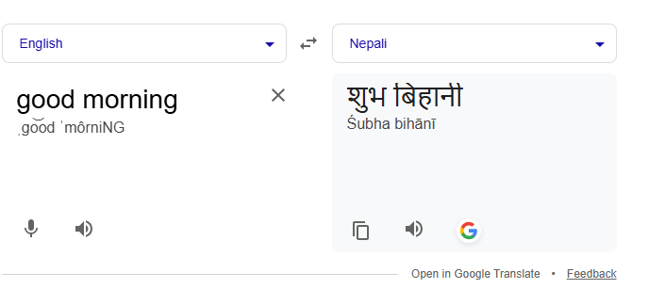
Machine Translation
It is a technology that allows computers to automatically translate text or speech from one language to another.
It is a subfield of Artificial Intelligence and Natural Language Processing.
Example —English → Nepali
“Good Morning?” → “शुभ बिहानी”.
Used in apps like: Google Translate.
Presented By: Regisha Maharjan

Slide 23
Types of Machine Translation
1
Rule-Based Machine Translation (RBMT)
2
Statistical Machine Translation(SMT)
3
Neural Machine Translation (NMT)
4
Hybrid Machine Translation (HMT)
Presented By: Regisha Maharjan

Slide 24
Rule-Based Machine Translation (RBMT)
This system follows predefined grammar rules and a dictionary.
For example, if we translate the sentence ‘I eat rice’ from English to Nepali, the system first looks at each word and then rearranges the sentence based on grammar rules.
RBMT = Rules
Advantage:
Disadvantage:
No need for large data
Works well for simple sentences
Not flexible
Poor for complex sentences
Presented By: Regisha Maharjan

Slide 25
Statistical Machine Translation
It works based on probability and large amounts of data.
Instead of using grammar rules, the system learns from previously translated sentences.
SMT = Data + Probability
Example — “How are you?”
Now system checks data:
80 times → “तिमीलाई कस्तो छ?”
10 times → “तिमी कस्तो छौ?”
5 times → something else
So it picks: “तिमीलाई कस्तो छ?” (highest probability)
Presented By: Regisha Maharjan

Slide 26
Neural Machine Translation (NMT)
It uses translation using AI (like how humans understand meaning).
NMT is like a human translator who understands the full meaning before translating.
Example — “I am feeling very cold today” Old method (word-by-word):
NMT method:
I → म
am → छु
feeling → महसुस गर्दै
cold → चिसो
Understands meaning → gives natural sentence:
“आज मलाई धेरै चिसो लागिरहेको छ”
Presented By: Regisha Maharjan

Slide 27
Hybrid Machine Translation
Combination of different approaches.
It is a blend of RBMT and SMT.
Its goal is to get better and more accurate translation.
Example — “I eat rice” How HMT works:
Uses rules → correct grammar
Uses data → common usage
Uses AI → natural meaning
Final output:
“म भात खान्छु” (correct + natural)
Presented By: Regisha Maharjan

Slide 28
Machine
Vision
It is the technology that enables machines to ‘see’, analyze, and understand visual information like images or videos.
It is widely used in industries for quality control, defect detection, and guiding robots.
It is faster and more accurate than humans but can be expensive and needs controlled environments.
Presented By: Regisha Maharjan

Slide 29





How Machine Vision Works
1
2
3
4
5
Image
Acquisition
Image
Preprocessing
Image Processing
/ Analysis
Decision
Making
Output
/ Action
→
→
→
→
Presented By: Regisha Maharjan

Slide 30
How Machine Vision Works — Details
Image Acquisition
Capture images using camera or sensor. Example: Take photo of a product on a production line.
Image Preprocessing
Improve image quality: remove noise, adjust brightness/contrast. Ensures accurate analysis.
Image Processing / Analysis
Detect features, patterns, defects, shapes, or objects. Example: Identify if label is missing.
Decision Making
System decides action based on analysis. Example: Correct → pass; Defective → remove.
Output / Action
Actuators, robots, or devices perform the task. Example: Robot removes defective bottle from line.
Presented By: Regisha Maharjan

Slide 31
Components Of Machine Vision System
Image Acquisition
Capturing the image from the real-world object. Key devices like Camera, image sensor are used. Example: Industrial camera capturing a product on the assembly line.
Optics / Lens
Focuses the image on the sensor. Choice of lens affects magnification, resolution, and field of view. Example: Telecentric lens for precise measurement in manufacturing.
Lighting
Proper illumination to enhance image quality. Types: Backlight, diffuse, structured light. Example: Using LED lights to detect scratches on metal.
Presented By: Regisha Maharjan

Slide 32
Components (continued)
Image Processing Unit / Vision Processor
Processes the captured image using algorithms to extract useful information. It performs tasks like filtering, segmentation, and pattern recognition. Example: Identifying defects in a product automatically.
Communication Interface
Sends processed data to other systems (e.g., robot controller, computer). Example: Ethernet, USB, or industrial fieldbus connections.
Decision Making / Output
Based on processed information, takes appropriate action. Example: Rejecting defective items from a production line.
Presented By: Regisha Maharjan

Slide 33
Application
1
Industrial Automation
2
Robotics
3
Medical and Healthcare
4
Traffic and Transportation
5
Security and Surveillance
Presented By: Regisha Maharjan

Slide 34
Object detection and recognition
One of the most investigated tasks in computer vision.
It is one of the most widely studied and researched problems in the field of computer vision.
More challenging than image classification alone.
only tells what is in the image (e.g., cat, dog)
More challenging task: also needs to find where the object is + what it is
Presented By: Aayush Chaudhary

Slide 35
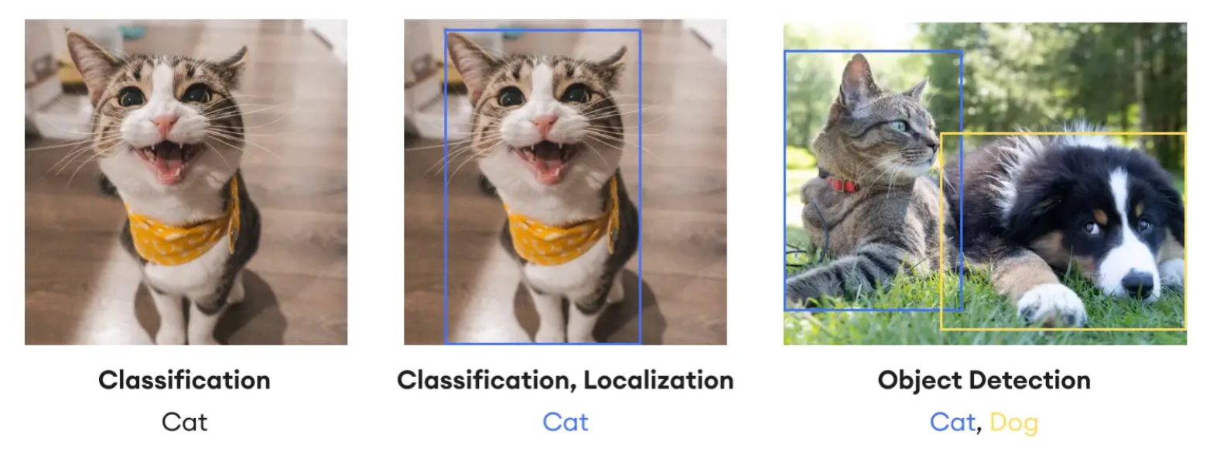
Key Terminologies Compared
Image Classification
Categorizes an entire image into a predefined class.
Object Localization
Identifies where an object is in an image.
Object Detection
Identifies what and where (classification + localization with bounding boxes).
Presented By: Aayush Chaudhary

Slide 36
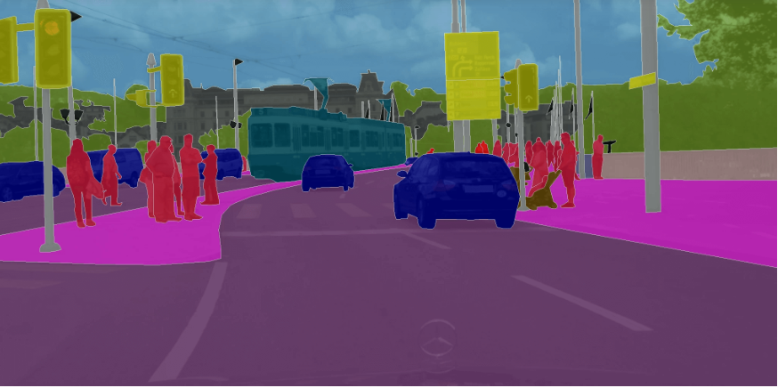
Image Segmentation
Divides an image into distinct clusters of pixels (segments).
Segments shown in different colors.
Helps break down complex visual information.
Presented By: Aayush Chaudhary

Slide 37
Use of machine vision in cameras
1
Machine Vision in Social Media
2
Machine Vision in Manufacturing
3
Machine Vision in Healthcare
4
Machine Vision in Robotics
Presented By: Aayush Chaudhary

Slide 38
Explainable AI in computer vision
Making AI systems show how and why they made a decision when analyzing images.
Common techniques:
Heatmaps (Saliency maps):
highlight important pixels
Grad-CAM:
shows important regions in deep learning models
Bounding attention maps:
show where the model focused
Presented By: Aayush Chaudhary

Slide 39
AI in health care and bioinformatics
Artificial Intelligence (AI) is transforming healthcare and bioinformatics by improving diagnosis, treatment, drug discovery, and patient management.
AI-powered solutions enhance medical research, automate tasks, and provide personalized healthcare for better patient outcomes.
Presented By: Preshna Thapa

Slide 40
Application of AI in Medicine
AI is widely used in medical diagnostics, patient monitoring, robotic surgery, and drug discovery. Some key applications include:
Medical Imaging and Diagnostics:
Personalized Medicine and Treatment Plans:
AI analyzes X-rays, MRIs, CT scans, and ultrasounds to detect diseases. Uses deep learning models to identify abnormalities like tumors, fractures, and infections. Reduces human errors and improves early disease detection.
Example: AI-based systems like Google’s DeepMind and IBM Watson Health assist radiologists in detecting cancer
AI analyzes X-rays, MRIs, CT scans, and ultrasounds to detect diseases. Uses deep learning models to identify abnormalities like tumors, fractures, and infections. Reduces human errors and improves early disease detection.
Example: AI-based systems like Google’s DeepMind and IBM Watson Health assist radiologists in detecting cancer
Presented By: Preshna Thapa

Slide 41
Predictive modelling in Healthcare
Disease Prediction and Early Detection
AI analyzes patient records, lab tests, and genetic data to predict diseases like cancer, diabetes, and heart disease. Improves early intervention and preventive care.
Example: Google’s AI model predicts breast cancer with higher accuracy than human radiologists.
Predicting Patient Outcomes and Treatment Effectiveness
AI predicts treatment success rates and patient recovery time based on medical history. Helps doctors personalize treatments for better results.
Example: AI models in ICUs predict which patients need ventilators based on their health status.
Hospital Resource Management
AI predicts hospital admission rates, ICU occupancy, and emergency room demand.
Helps in staffing, bed management, and reducing patient wait times.
Example: AI-powered COVID-19 prediction models helped hospitals prepare for patient surges.
Genomic Analysis and Precision Medicine
AI analyzes DNA sequences to identify genetic mutations linked to diseases.
Helps in designing personalized gene therapies.
Example: AI-based Deep Genomics predicts how genetic mutations affect human health.
AI for Mental Health and Well-being
AI chatbots provide mental health support and therapy sessions.
Analyzes speech patterns and behavior to detect depression and anxiety.
Example: Woebot is an AI-powered chatbot that helps users manage mental health.
Presented By: Preshna Thapa

Slide 42
Thank You

